Slide 1

Technology and Automation
Welcome!
To the training of our Technology Partners

Slide 2

OBJECTIVES
Focus of knowledge
The Company
The company's structure, missions, values and objectives
The Market
The competition, the partners and other players that integrate the automation world
The Client
The company's target market, and the focus structured for this market
The Know-how
Communicate
Engage
Challenges
Implement
Evolve

Slide 3
ORGANIZATIONAL
Mission and Values
MISSION
To be the best company of controllers of the market, offering the-state-of-the-art technology with the best cost-benefit and technical support; everything thought about and distributed by means of solid partnerships with integrators and installers
VALUES
Transparency and Independence
Partnership (focus on the client)
Complete solution
Continuous evolution
Entrepreneurship

Slide 4
ORGANIZATIONAL
Executive Board
EZTech was founded in 2003 by Kelvin Ussher, and in 2011 Ricardo Spinelli joined the company for commercial and administrative leverage

Slide 5

ORGANIZATIONAL
Kelvin Ussher
TECHNICAL DIRECTOR Chief Technical Officer. Electronics engineer.
Started his career in his native country,
New Zealand in Automation, where he
worked for PEC for 10 years and was
co-founder of ITL, working in projects
in Latin America, Asia and South Africa.
In 2003 he founded EZTech after
moving permanently to Brazil,
working with major clients such as
Ipiranga, CTF and Grupo Pão de Açúcar.

Slide 6

ORGANIZATIONAL
Ricardo Spinelli
COMMERCIAL DIRECTOR Civil engineer with significant experience
in the commercial segment of the oil and
gas industry. He started at EZTech in
2011 responsible for the commercial,
administrative and financial areas .

Slide 7
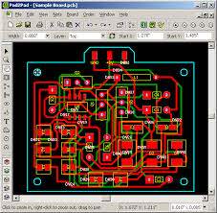
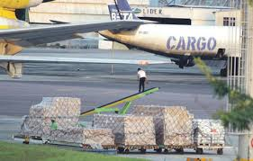
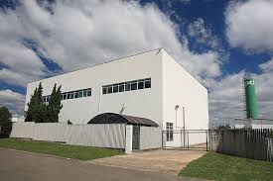

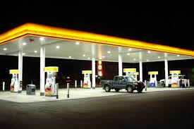
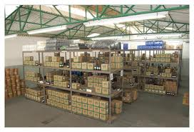
ORGANIZATIONAL
Structure
National design and know-how
Import of components
and raw materials
Assembly in Arujá
Post-sales
Installation by
qualified partners
Distribution and Commercialization

Slide 8
OBJECTIVES
Focus of knowledge
The Company
The company's structure, missions, values and objectives
The Market
The competition, the partners and other players that make up the automation world
The Client
The company's target market, and focus structured for this market
The Know-how
Communicate
Engage
Challenge
Implement
Evolve

Slide 9
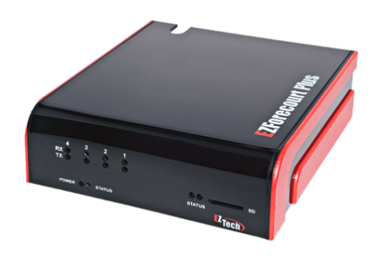
CONTROLLERS
Forecourt controller
Input
Processing
Output
Pumps
Integrator
Equipment
System / POS
Tank
Gauge
9

Slide 10
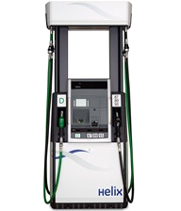
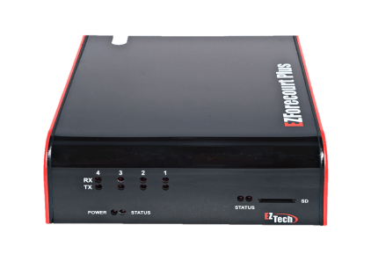
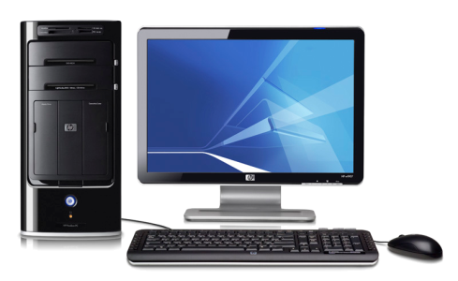
CONTROLLERS
Forecourt controller
10

Slide 11
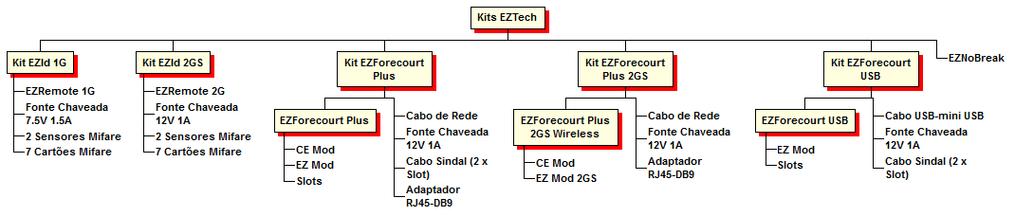
CONTROLLERS
EZTech product tree
11
Notes:
Fonte Chaveada – Switched Source
Sensores Mifare – Mifare Sensors
Cartões Mifare – Mifare Cards
Cabo de Rede – Network Cable
Cabo Sindal – Sindal Cable
Adaptador – Adapter
Cabo USB – USB Cable

Slide 12
PUMPS
Main Players
LIQUID FUELS
CNG
DRESSER WAYNE
ASPRO
GILBARCO
GALILEO
TOKHEIM
Together, these manufacturers represent the largest marketshare slice for pumps. The pumps send the information.
Notes:
VNG – Vehicular Natural Gas

Slide 13
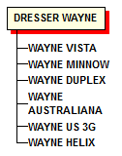
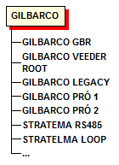
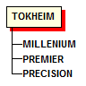
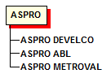
PUMPS
Manufacturers product tree
These represent 80% of the market. Remembering that the total variety of pumps in the field is much greater than that.

Slide 14
SOFTWAREHOUSES
Software
PUMP
PUMP
Information
AUTOMATION
Information
SYSTEM
Information
PUMP
Information
Information
PUMP

Slide 15
REPRESENTATIVES
Distributors of the softwarehouses
Client
Softwarehouse
Distributor
Client
Client

Slide 16
MARKET UNIVERSE
Players and the management system
SOFTWARE
Managerial control, tax part
REPRESENTATIVE
PUMP
Sale, local
support
Gas station automation and management system
Fueli and
information
Sale and
distribution
of fuel
Metering,
Report
DISTRIBUTORS
AND GAS STATIONS
TANK GAUGE
Data integration
AUTOMATION

Slide 17
OBJECTIVES
Focus of knowledge
The Company
The company's structure, missions, values and objectives
The Market
The competition, the partners and other players that integrate the automation world
The Client
The company's target market, and the focus structured for this market
The Know-how
Communicate
Engage
Challenges
Implement
Evolve

Slide 18
COMMERCIAL OBJECTIVE
Commercial structure
Client
EZTech
Client
Softwarehouse
Client
Distributor
Client
Client

Slide 19
OBJECTIVES
Focus of knowledge
The Company
The company's structure, missions, values and objectives
The Market
The competition, the partners and other players that integrate the automation world
The Client
The company's target market, and the focus structured for this market
The Know-how
Communicate
Engage
Challenges
Implement
Evolve

Slide 20
EVOLUTION AND QUALITY
Evolution and quality
Feedback is important for the development of the products or services supplied by the company.
A proactive communication with the managers means having the initiative of moving the company ahead
There are two forms of product development
Maintenance development
New development
And two forms of service development
Internal feedback
Feedback from the representatives

Slide 21
EVOLUTION AND QUALITY
Client Relationship Guide
Focus, posture and radar.
90% of the secret of the relationship is to be present, next to the client.
Rule of 3:
3 action plans
3 days with no contact
3 attendances in less than 30 days

Slide 22
INSTALLATION
Overview

Slide 23
INSTALLATION
Tools
MULTIMETERS
TOOLS CABLES (Cutting pliers, needle-nose pliers, screwdriver, phillips screwdriver, etc.)
DATA CABLE
MANUALS
SOFTWARE TOOLS
BACKUP (if possible)

Slide 24
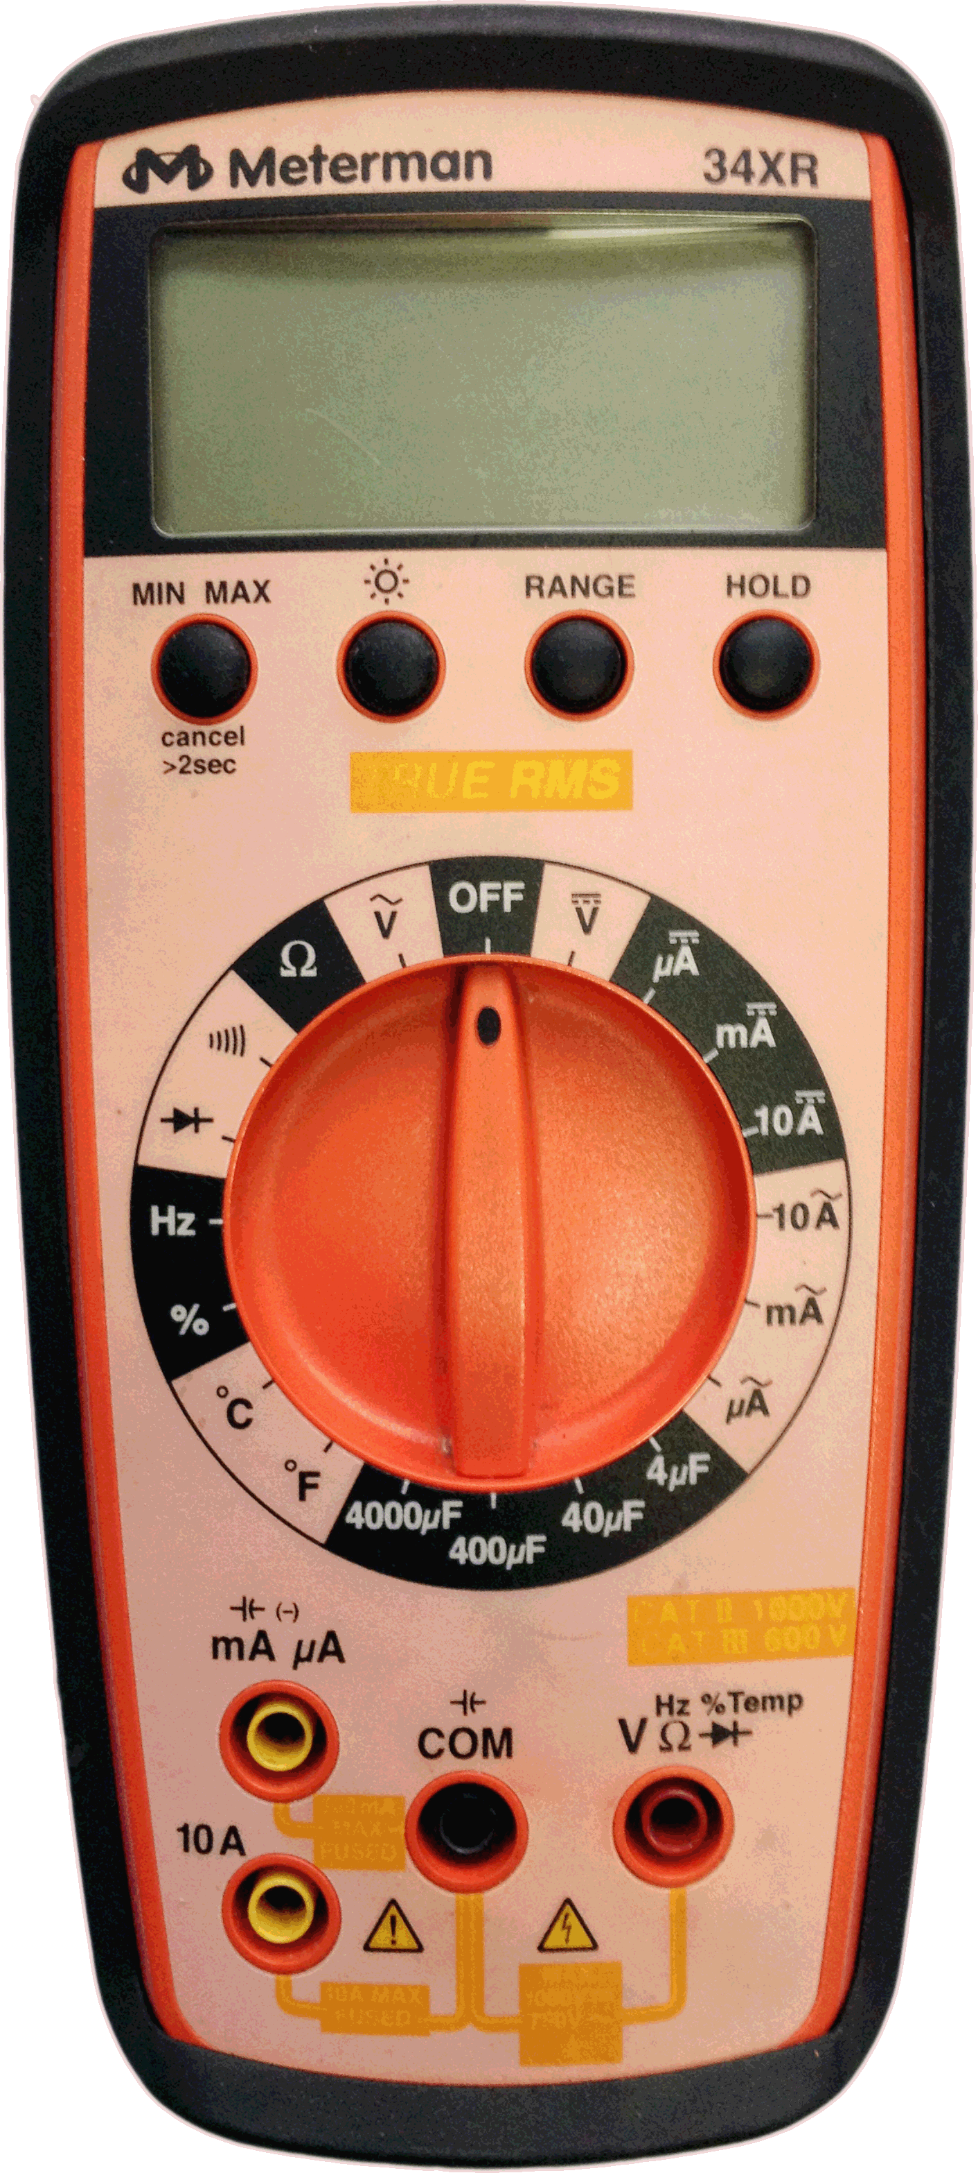
INSTALLATION
Tools
TYPES OF METERING APPLICABLE IN AUTOMATION
DC VOLTAGE
AC VOLTAGE
OHMS
 DIODE SCALE

Slide 25
INSTALLATION
Tools
With the Direct Current Voltage metering you can:
Check if the cables are connected properly or inverted;
Check if the slot is working;
Check if the data cable is ruptured;
Check the possibility of having the pump’s
CPU having a problem;
V
Vcc
Vdc

Slide 26
INSTALLATION
Tools
With the Alternating Current Voltage metering you can:
Check if the components power is adequate;
~
V
Vac

Slide 27
INSTALLATION
Tools
Typically: all you have to do to use the multimeter is to adjust the position on its center for which scale you want to measure.
After making sure of the position all you have to do is to place the test point probes on the metering points you want.
-
+

Slide 28
INSTALLATION
Tools
The diode and resistance metering are much more specific and will only be used when requested.
The digital multimeter also works in different scales. With the pointer adjusted in the 20 Vdc scale the values on the display will vary between -20V and 20V, never exceeding those thresholds.
Also, the orientation of the positive and negative values when in Vdc is just a reference for knowing if the test points are connected directly or inversely to the polarities you are measuring.

Slide 29
INSTALLATION
Tools
Caution when selecting the scale on the multimeter, for selecting the wrong scale can cause certain components to burn when metering !

Slide 30
INSTALLATION
Tools
A roll of data cables is very useful to test the communication with the pumps or EZRemotes (gas station attendants identifiers) effectively.
In the integration and support area of the website www.eztech.ind.br there is a part only for downloads.
On it you have the Installation Manual and the other software tools.

Slide 31
PUMP
Recommendations for Infrastructure
• Make sure that the fuel pump is in perfect conditions, with no signs of damage.
• Check if the local voltage is in accordance with the standard from the electric utility company of your region;
• If the network is unstable, use a no-break. To install it, follow the guidance of an electrical engineer;

Slide 32
PUMP
Recommendations from Infra
• The electrical sizing of the gas station (power input) must consider all the electrical and electronic equipment which will be powered;
• The electrical installation for the pump must be separate, one installation for the electronic head and the other for the motors;
• The value of the grounding resistance must be below 4 Ω (Ohms), measured individually between the ground and the rod;
• Check if the grounding cable is connected to the place recommended in the connection box;

Slide 33
PUMP
Recommendations from Infra
• Never connect the ground wire to the busbar, nor to a painted surface so as not to insulate the system;
• Each pump model has a corresponding sump, adequate for the size of its base.

Slide 34
PUMP
Recommendations from Infra
Install the circuit breakers on a proper electric switchboard, which must be housed in a easily accessible place and at a safe distance from the equipment.
Clearly identify the circuit breakers with the aid of labels.
The following values of overload magnetic circuit breakers are recommended for the connections:

Slide 35
PUMP
Electrical Recommendations from Gilbarco
• ELECTRONIC HEAD of all the pump models: adjusted bipolar circuit breaker between 2 A and 4 A for 220 Vac.
• MOTOR – single or dual pumps: tripolar circuit breaker of 8 A and 220 Vac or 380 Vac.
• MOTOR - 140 lpm single pumps, dual, four-way with 2 or 4 simultaneous supplies, six-way with 2 simultaneous supplies or eight-way with 2 simultaneous supplies : tripolar circuit breaker of 10 A and 220 Vac or 380 Vac.
• MOTOR - 200 lpm single pump or six-way with 4 simultaneous supplies : tripolar circuit breaker of 15 A and 220 Vac or 380 Vac.

Slide 36
PUMP
Electrical Recommendations from Gilbarco
• MOTOR - 400 lpm single pump or eight-way with 4 simultaneous supplies : tripolar circuit breaker of 20 A and 220 Vac or 380 Vac.

Slide 37
PUMPS
Manufacturers product tree
These represent 80% of the market. Remembering that the total variety of pumps in the field is further than that.

Slide 38
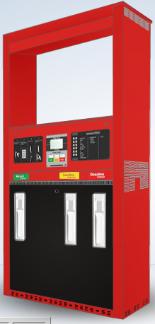
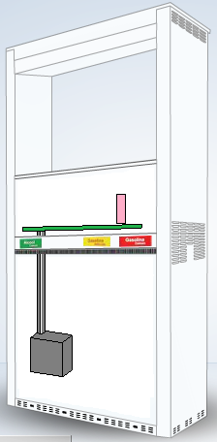
PUMP
HEAD
X-RAY
BODY
X-RAY
CPU
CPU POWER
ANTI-EXPLOSION BOX
SUMP

Slide 39
PUMP
Characteristic installation points of fuel pumps
CPU communication point (Communication interface)
CPU (communication protocols)
Data Cable
Anti-Explosion Box

Slide 40
PUMP
Division
Typically, the pump is divided into 3 parts:
Hardware
Configurable electronics (logical address and local/remote work mode)
Non-configurable electronics (protocol and communication media)

Slide 41
PUMP
PUMP (INTERNAL)
CPU
DATA
PROCESSOR
COMMUNI-
CATION PROCESSOR
AUTOMATION
(REMOTE)
MECHANICAL HARDWARE

Slide 42
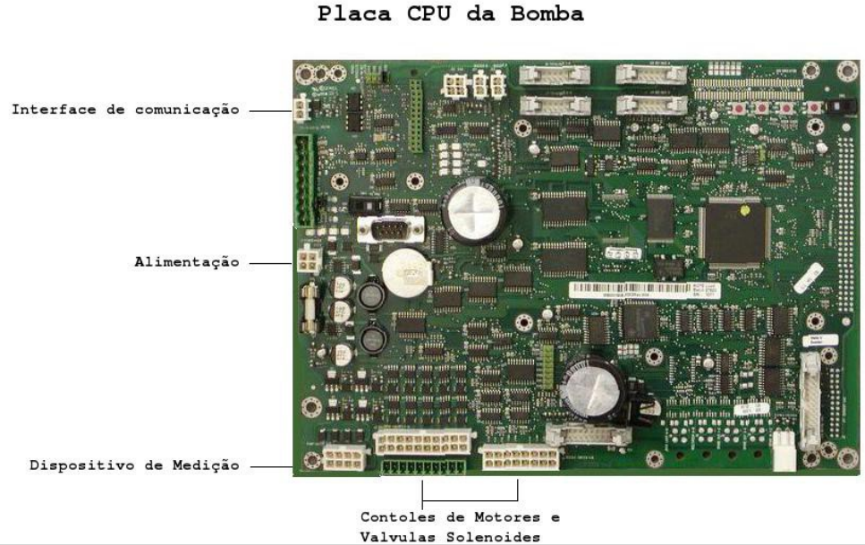
PUMP
Information processing in the pump
The information obtained by controller are ALWAYS accessed by means of the communication interface existing in the Pump CPU and the protocols made available by means of the “data cables” installed by the manufacturer at the “communication interface” output.
Typical example of pump CPU board
Communication
interface
Power
Metering device
Control of Motors and Solenoid Valve
Examples of information available through this interface are:
1. Status of pump and closures
2. Totals of fuelling
3. Release and blocking of pumps
4. Readout and change of product prices

Slide 43
PUMP
Information processing in the pump
Typical example of pump CPU board
Communication
interface
Power
Metering device
Control of Motors and Solenoid Valve
Typical localization of the communication interface in Pumps CPU (in red)

Slide 44
PUMP
Front View
Top View

Slide 45
PUMP
POS. ABAST.
side 1 | side 2
Top View
X-Ray

Slide 46
PUMP
POS. ABAST.
PA 1
PA 2
side 1 | side 2
side 1 | side 2
X-Ray
Fuel. Pos.

Slide 47
PUMP
POS. ABAST.
Front View
Top View

Slide 48
PUMP
POS. ABAST.
side 1 | side 2
side 1 | side 2 side 3 | side 4
Ou
side 3 | side 4
Top View
X-Ray

Slide 49
PUMP
POS. ABAST.
PA 1
PA 2
side 1 | side 2 side 3 | side 4
side 1|side 2
side 3|side 4
PA 3
PA 4
PA 1
PA 2
side 1 | side 2
side 1 | side 2
side 3 | side 4
side 3 | side 4
PA 3
PA 4
X-Ray
Fuel. Pos.

Slide 50
PUMP
POS. ABAST.
PA 1
PA 2
side 1 | side 2

Slide 51
PUMP
POS. ABAST.
PA 1
PA 2
side 1 | side 2 side 3 | side 4
PA 3
PA 4

Slide 52
AUTOMATION
Controllers
The EZForecourt is a pumps and tanks managment system (also known as forecourt controller), which allows controlling the data from any kind of liquid fuel or CNG pump, as well as monitoring tank gauges.
Each unit can manage up to 16 physical pumps, or 32 fuelling positions, which permits, for instance, a management capacity of up to 96 nozzles in six-way pumps.
Communication with the pumps takes place by wireless remote connections, or physical connections having: Current loop, RS485, Tokheim and Schlumberger, COMPAC, which allows integration with the main manufacturers: Gilbarco, Dresser Wayne, Tokheim, Aspro and Galileo, ...
The pieces of equipment are relevant for the market for tax controls such as the PAF-ECF; operational controls such as productivity and financial control such as cashier closing among others.

Slide 53
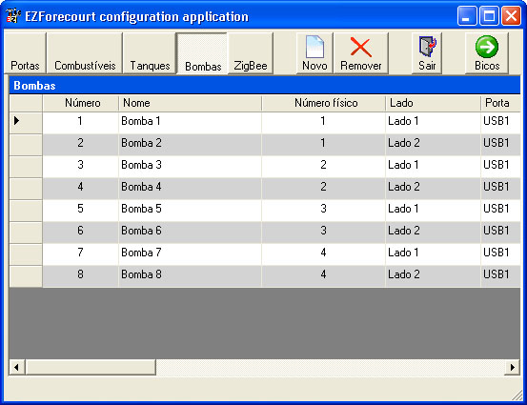
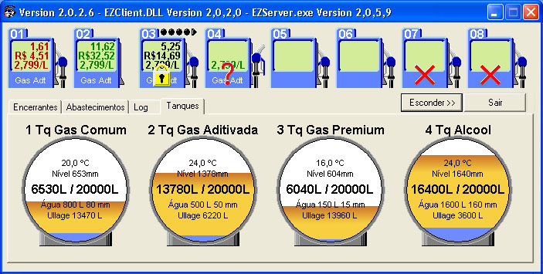
AUTOMATION
To make use of the forecourt controller functions, it is necessary to install support applications, This is done in the server computer and/or in any other computer from a network, as long as it points to the computer where the EZForecourt was installed or to the EZForecourt Plus itself.
EZConfig
sets up the relation of pumps and tanks with the forecourt controller.
EZMonitor
monitors the tank gauges, fuelling, closures and logs.
The EZForecourt has further clients to emulate other controllers and to integrate with the Passo solution ...
53

Slide 54
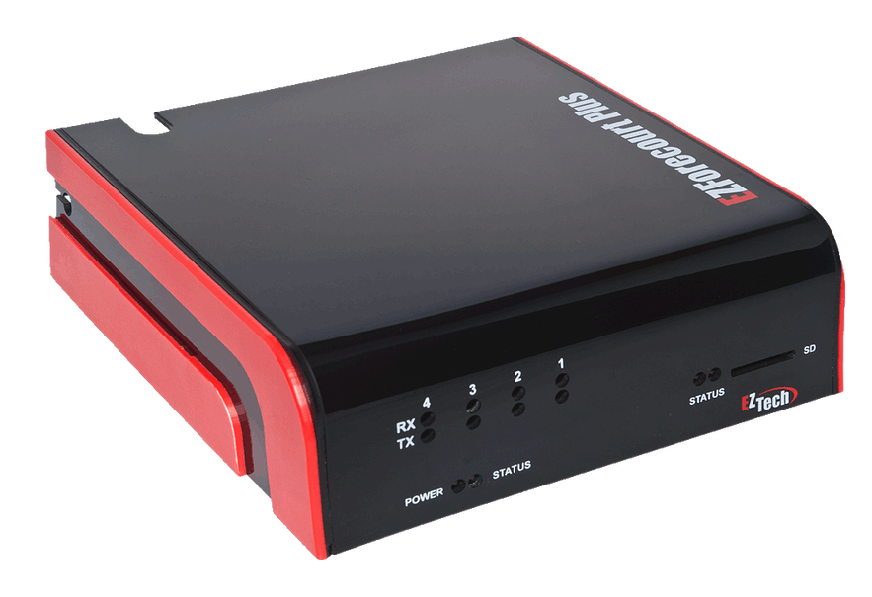
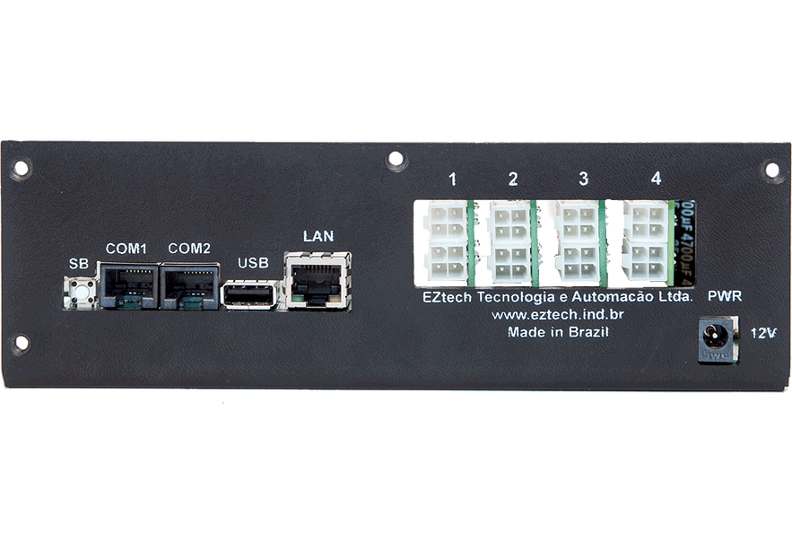
AUTOMATION
EZForecourt Plus Controller
Client-server arquitecture with no server computer required.
Client to access the functions directly.
The server is also the forecourt controller.
Accessed from any computer or hub on the network
Up to 100 thousand offline fuel deliveries.
Serial port on the controller
Connection by the LAN port
Pumps communicate through slots
54

Slide 55


AUTOMATION
EZForecourt Plus Controller
Windows CE
The EZForecourt Plus is a stand-alone equipment and for that reason it is necessary to have its own operating system. Given that it was developed for mobile devices, windows CE is fully runnable even with less than 1 Mb of RAM and still permits the hosting of various applications. That is, having a EZForecourt Plus is literally like having a computer in your hands.
ARM9 and ARM7 Processors
The leading processor of the embedded systems in double dose. While the ARM7 does all the hard work of communicating with the pumps, the ARM 9 is dedicated to hosting Windows CE and server applications. Such integration makes us comfortable to state that the EZForecourt Plus is today the fastest controller on the market.
55

Slide 56


AUTOMATION
EZForecourt Plus Controller
TCP/IP Protocol
On account of being based on the internet communications protocol, the equipment can transmit the data to the management system directly, needing only to be connected to any point of the gas stations LAN. In addition to making the physical installation easier, such a feature allows monitoring the forecourt from anywhere outside the office..
Local data server
The gas station data is stored in the controller, which means total independence from any computer. In the case of access failure by the management system, the controller can accumulate more than 100 thousand offline deliveries.
56

Slide 57
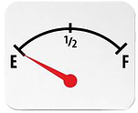
AUTOMATION
EZForecourt Plus Controller
Pumps and protocols
1. Manages up to 16 physical pumps regardless of the number of nozzles.
2. Current loop physical connections, RS485 and Tokheim; liquid or gas.
﻿3. Communication with mechanical pumps by third-party pulser.
﻿4. Communication with any electronic pump.
Tank gauge readout
Access to the information from tanks by means of main gauges on the market:
• Veeder Root TLS-350, TLS-350R and TLS-200
• Telemed
• MedLiq
• RSP S2 TCP/IP and S2 serial
• OPW
Contact us for other models.
57

Slide 58
AUTOMATION
EZForecourt Plus Controller
Connection with the pumps
Current Loop Boards, RS485, Tokheim or Schlumberger, COMPAC all opto-isolated, which drastically increases the protection of the components in case of overload or power variations. The controller accepts up 4 boards of any kind and each board manages up to 4 physical pumps of the same protocol, regardless of the number of nozzles, which makes a total of 16 pumps per controller.
Offline deliveries
In case of loss of communication with the management system, it accumulates more than 100,000 independent deliveries with date and time with no interruption of the automation of pumps and gauges.
System requirements
Windows 32 or 64 bits and Linux
Any type of network topology
Processor and memory
ARM9 RISC 200mhz. 64mb RAM and 1GB of flash; and
ARM7 RISC 64mhz. 64mb RAM and 304kb of flash
58

Slide 59
AUTOMATION
EZForecourt Plus Controller
Power and battery
External power supply with bi-volt input and 12v output. Optional accessory battery (EZNoBreak) on purchase, with duration of 2h.
Cables
Management system: network cable with automatic polarity
Automation: AWG cable. Up to 50m, use AWG22 or 0.5 mm2. Above, use AWG 18 or 0.75 mm2
Languages
Portuguese and English.
Box contents
1 controller with quantity and type of boards requested in the order
1 Power supply
1 LAN cable
4 connectors for pump automation cables
1 Converter RJ45/DB9
59

Slide 60
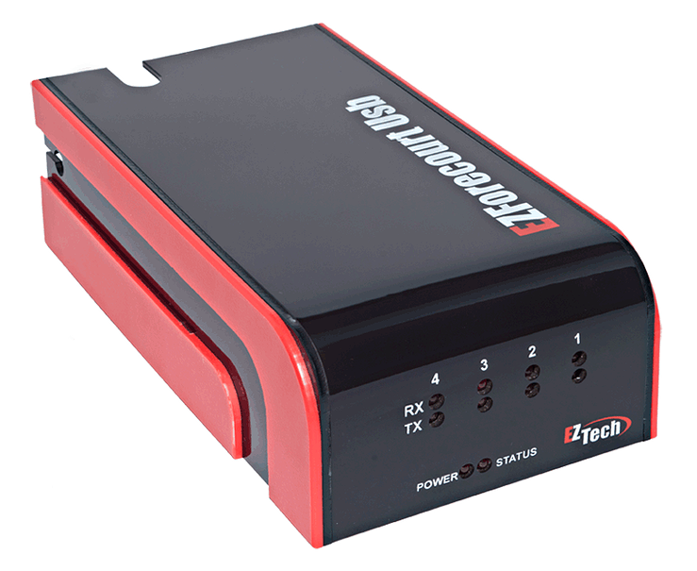
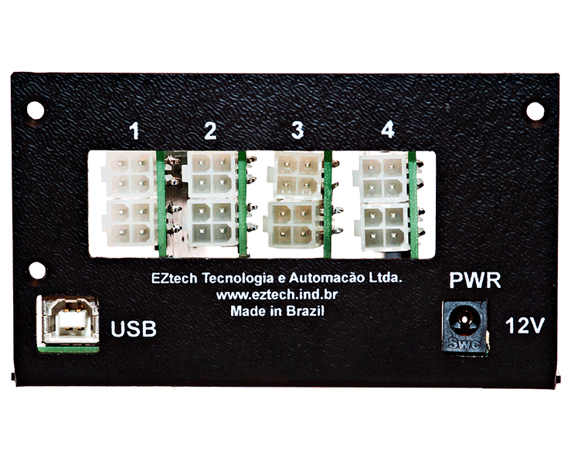
AUTOMATION
EZForecourt USB Controller
Client server with computer
Needs the client to access the functions
The management and configuration server is the computer where the EZServer service is hosted.
Accessed from the server
Up to 2 thousand offline deliveries.
Serial ports COM1 to COM10 via the server computer
Connection via USB port
60

Slide 61
AUTOMATION
EZForecourt USB Controller
Installation in Windows
The EZForecourt USB uses the client’s computer to carry out the management of deliveries, gas station attendants and also the configuration.
ARM7 Processors
The leading processor of the embedded systems. The ARM7 does all the hard work of communicating with the pumps and the PC stays in the management of configuration and deliveries.
61

Slide 62
AUTOMATION
EZForecourt USB Controller
USB Communication
On account of being bases on a USB communication protocol, the equipment can transmit the data to the management system, only requiring it to be connected directly to a networked computer.
.
Local data server
The gas station data stays stored in the controller itself in flash memory. In case of failure of the delivery monitoring application or of the management system, the controller can accumulate more than 2 thousand offline deliveries.
62

Slide 63
AUTOMATION
EZForecourt USB Controller
Pumps and protocols
1. Manages up to 16 physical pumps regardless of the number of nozzles.
2. Current loop physical connections, RS485 and Tokheim; liquid or gas.
﻿3. Communication with mechanical pumps by third-party pulser.
﻿4. Communication with any electronic pump.
Tank meters readout
Access to the information from tanks by means of main meters on the market :
• Veeder Root TLS-350, TLS-350R and TLS-200
• Telemed
• MedLiq
• RSP S2 TCP/IP and S2 serial
• OPW
Contact us for other models.
63

Slide 64
AUTOMATION
EZForecourt USB Controller
Connection with the pumps
Current Loop Boards, RS485, Tokheim or Schlumberger, COMPAC all opto-isolated, which drastically increases the protection of the components in case of overload or power variations. The controller accepts up to 4 boards of any kind and each board can manage up to 4 physical pumps of the same protocol, regardless of the number of nozzles, which makes a total of 16 pumps per controller.
Offline fuelling
In case of loss of communication with the management system, it accumulates more than 3,000 independent deliveries with no date and time, with no interruption of automation of pumps and gauges
System requirements
Computer with Windows 32 or 64 bits and USB Ports
Processor and memory
ARM7 RISC 64mhz. 64kb RAM and 304kb of flash
64

Slide 65
AUTOMATION
EZForecourt USB Controller
Power and battery
External power supply with bi-volt input and 12v output. Optional accessory battery (EZNoBreak) on purchase, with duration of 2h
.
Cables
Management system: USB
Automation: AWG cable. Up to 50m, use AWG22 or 0.5 mm2. Above, use AWG 18 or 0.75 mm2
Languages
Portuguese and English.
Box contents
1 controller with quantity and type of boards requested in the purchase order
1 Power supply
1 USB cable
4 connectors for pump automation cables
65

Slide 66
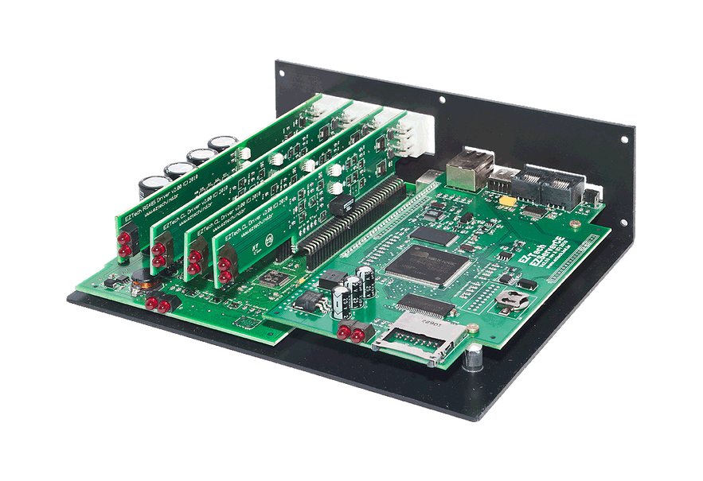
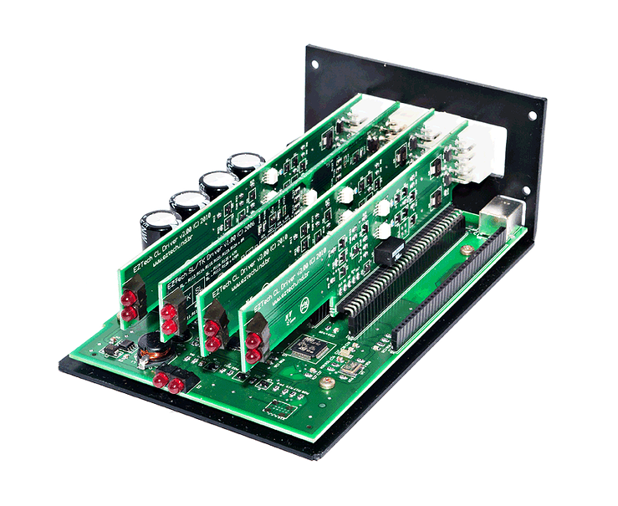
AUTOMATION
Basic Comparasion
EZForecourt Plus
EZForecourt USB
66

Slide 67
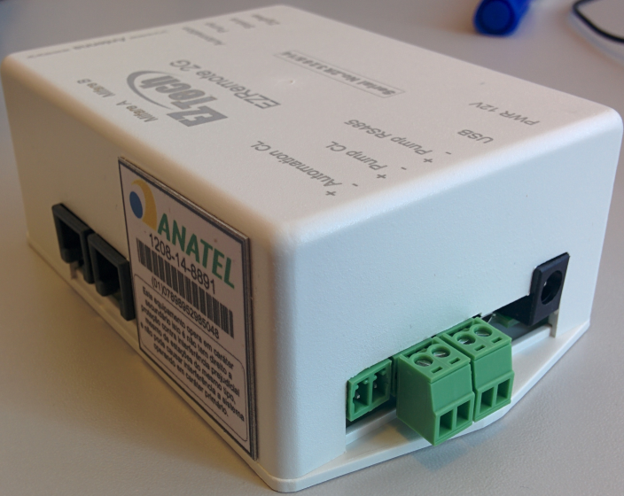
AUTOMATION
EZRemote Wireless
Its guideline is to carry out the release and blocking of the pumps that allow this kind of function
It is meant to be installed by the pump CPU, and to have a current loop and RS485 output to be used in accordance with the pump’s specifications.

Slide 68


AUTOMATION
EZId
Management of station attendants
With the EZId the pump only releases for fuelling by reading a card in possession of each gas station attendant. Each delivery must now be associated to a gas station attendant, which increases the transparency in management, in addition to allowing the implementation of internal policies by means of ascertaining the team’s performance.
Management of clients
In addition to the control of gas station attendant, the EZId features can be used in the accurate management of clients, needing only for them to have identification cards. Each fueling can now also be associated to a client, allowing invoicing control, frequency and support to loyalty programs.

Slide 69

AUTOMATION
EZId
Mifare Technology
The adopted readers and cards use a technology called Mifare, used in access control systems where a card is read in proximity to a reader, such as, for instance, a bus or subway. The cards are pre-numbered and can be configured by the EZConfig application, provided.
Fuellng Memory
Added to its strong management power comes its state-of-the-art technology which allows sturdiness in regard to communication. The processor has a memory capable of accumulating up to 1000 fuelling if the EZId loses communication with the automation. In this manner the gas station manages to operate normally until solving its infrastructure.

Slide 70
AUTOMATION
EZId
EZRemote processor
EZId 2GS - ARM7 RISC 32 MHz with built-in zigbee of 2.4 GHz and transfer rate of 250 kbps
System requirements
Any EZTech controller and electronic pump
Energy
External power source with bi-volt input and 12v output (EZRemote 2GS) to be connected in powering the pump’s computerized unit (CPU).
Box contents
1 EZRemote module
1 power source
2 waterproof Mifare readers
7 factory numbered Mifare cards
70

Slide 71
INSTALLATION
Installation of Automation
The installation of every automation is divided into three steps:
To establish communication between automation and PC’s;
To perform the automation configuration;
To perform the connection of the pumps;
The installation manual is created in this format. Chapters 1 and 2 are about how to establish communication of the automations with the client. Chapter 3 refers to the configuration. Chapter 4 is about connection with the pumps.

Slide 72
INSTALLATION
Installation of the EZForecourt Plus
Check the Microsoft .NetFramework installed;
To perform the installation of the EZForecourt Plus in a client PC;
Compatibilize the network addresses;

Slide 73
INSTALLATION
Installation of the EZForecourt Plus
3 manners of placing the automation IP:
EZSetup Program;
Easier mode, serves to enter the IP in the automation, to backup the configurations.
EZDownload Program;
More complicated mode, serves to enter the IP in the automation, to make the internal repair.
WDTEST Command ;
Only work if there is a PC that already communicates with the automation, used mainly to change the IP.

Slide 74
INSTALLATION
Installation of the EZForecourt Plus
ATTENTION!
The EZIPConfig serves to indicate to the EZTech programs of which the automation IP, i.e., it does not configure the automation IP!

Slide 75
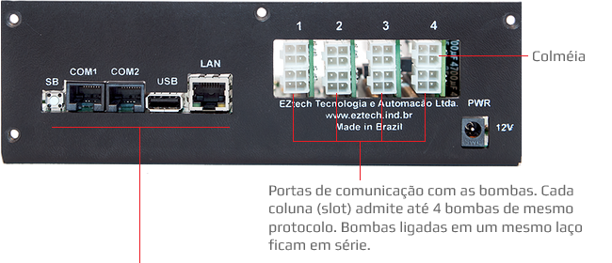
INSTALLATION
Connections of EZForecourt Plus
SB: Serial Boot. Initialization of the controller. COM1: Controller configuration or communication with tank meters. COM2: Communication with a second tank meter. USB: Connection of USB peripheral, configuration and extraction of controller data. LAN: Ethernet port for communication of the controller with the data network.
Notes:
Honeycomb
Communication ports with the pumps. Each column (slot) admits up to 4 pumps of the same protocol. Pumps connected in a same loop stays in series.

Slide 76
CONFIGURATION
Procedure to help
CONFIGURE A PUMP AND TEST IT BEFORE
MOVING ON TO THE NEXT ONE.

Slide 77
CONFIGURATION
Rule of slots
> There cannot be pumps of the same logical address in a slot (Except if installed with EZID)
> There cannot be pumps of different models in a slot (Except if they have EZID)
> Pumps with EZID and without EZID cannot be configured in a slot.
> More than 16 logical addresses cannot be connected in a slot (Fuel. Pos.) (Except Wireless).

Slide 78
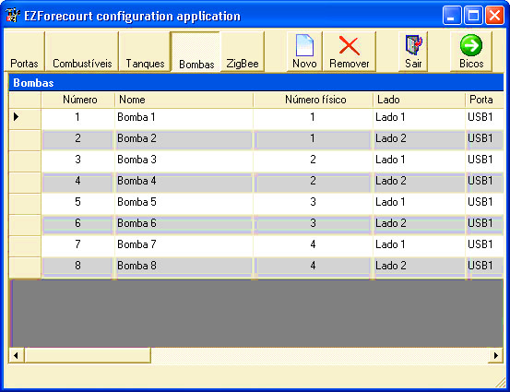
CONFIGURATION
PORTS
FUELS
TANKS
FUELLING POSITIONS
NOZZLES
EZConfig
EZConfig
sets up the relation of pumps and tanks with the controller.

Slide 79
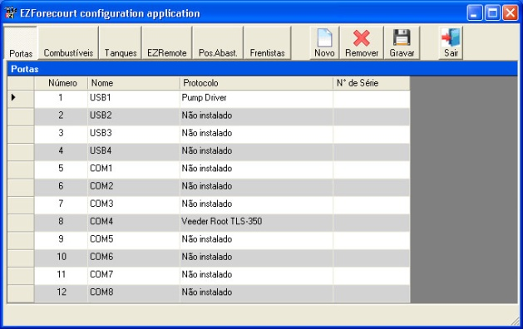
CONFIGURATION
Ports
USB Ports: the USB1 port refers to the main controller. The other ones are for using extra controllers.
COM Ports : are used for connecting with tank meters. The ones existing in the computer where the EZServer is installed can be configured in the EZForecourt USB. In the EZForecourt Plus, only the ports COM1 and COM2 íare available in the rear of the equipment.
Communication by IP: There are meters that are connected by means of an IP address.

Slide 80
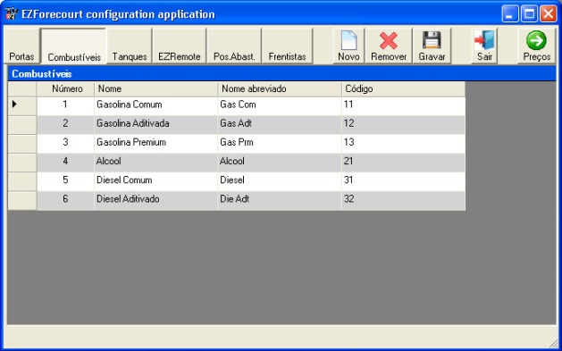
CONFIGURATION
Fuels
All the fuels configuration will be displayed. It is also possible to change the prices of the fuels in general.
DESCRIPTION OF FIELDS
• Number: Sequential identification generated by the system, editable however.
• Name: Description of the fuel
• Abbreviated name: Initials of the fuel.
• Code: Identification of the fuel given by the user.

Slide 81
CONFIGURATION
Tanks
In this stage ports with associated meters and fuels already registered must be associated to their respective tanks.
Further ahead the nozzles will reference the respective tanks.
DESCRIPTION OF FIELDS
Number: Sequential identification generated by the system, editable however
Name: Description of the Tank
Fuel: Fuel present in the tank
Capacity: Volume of the tank
Diameter: Size of the tank
Type: Manual (does not use probe) or Metered (uses probe)
Meter port: Port that was associated to the protocol of the meter in the ports configuration screen. For the case of meters connected by IP, select the IP referent to the meter in question.
Probe: Identification of the port of the meter that is being used by the probe

Slide 82
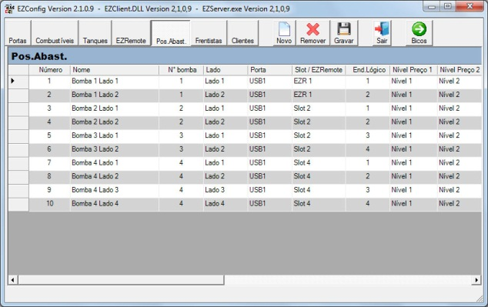
CONFIGURATION
Fuelling Positions
PRELIMINARY CONCEPTS
Logical Address x Pump No.: What actually identifies for any automation system is not the external number attached to the same (Pump No.) and rather the number assigned to each side by means of the panel keyboard , which is called herein Logical Address.
Fuelling point (PA): It is each side of the pump defined by a logical address. Each physical pump is entered in the register as many times as its actives sides, regardless of the number of nozzles.

Slide 83
AUTOMATION
Description of the P.A. fields
Number: Identification of the PA (generated by the system, editable however)
Name: Free description of the PA
Pump No.: External numeric identification of the pump. It will repeat itself for each PA.
Side: Identification of the pump face
Port: Port associated to the pump protocol “pump driver” in the ports list
Slot/EZRemote: controller board where the physical pump is connected or identification of the EZRemote to which the pump is connected.
Logical address: Sole numeric identification defined in each PA (side) in the pump
Price Level 1: Main fuel price in the PA.
Price Level 2: Alternate fuel price in the PA
Price format: Price format in the PA. It must be equal to the one configured on the side of the pump.
Volume format: Volume format in the PA. It must be equal to the one configured on the side of the pump.
Value format: Value format in the PA. It must be equal to the one configured on the side of the pump.
Type of pump: Protocol referent to the type of pump. It can be found in the description of the configuration for each pump, in chapter 5.
The price levels need to be previously registered in the fuel price screen.
83

Slide 84
AUTOMATION
Description of the P.A. fields
Authorization : Form how the fuelling is authorized in the PA. It can be:
Disabled – The pump is prevented from working.
Manual – The fuelling can only be authorized manually by a remote system.
Automatic – The fuelling is authorized, however it remains pending to be sent to the management system until it is released individually and/or the option “Memory” is configured as “Automatic”.
Gas Station Attendant RFID - Authorization of the “Automatic” type with the use of EZId for releasing each fuelling.
Memory: The information of the finalized fuelling must be transferred to a pile (memory) of pendency for payment to release the pump. This memory can be configured as:
Disabled – The pile is disabled and the pump is only authorized if the fuelling is paid for.
Manual – Any finalized fuelling needs to be manually sent to the pile by an operator so that a new fuelling can be initiated.
Automatic – Any finalized fuelling is sent automatically to the pile and a new fuelling is initiated.
Pre-Paid: Indicates if the pump admits pre-paid fuelling in the PA
Pre-Autho: Indicates if the pump allows pre-authorized fuelling in the PA
84

Slide 85
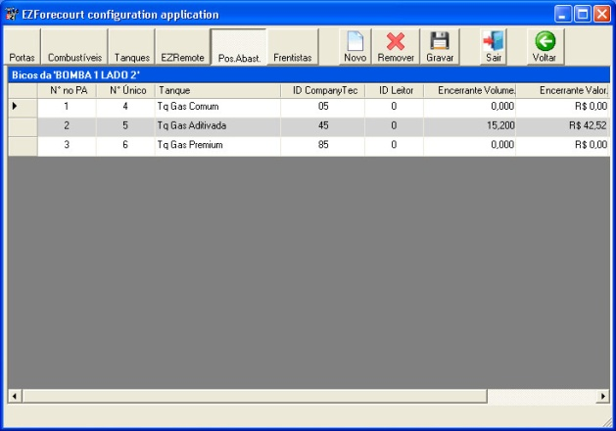
CONFIGURATION
Nozzles
DECRIPTION OF FIELDS
* Number: Sequential identification generated by the system, editable however
Physical Number: Sole numerical identification of the nozzle
Tank: Tank which the nozzle is associated to
Reader ID: Identification of the fidelity card reader
* Volume closure: total of volume sold in the nozzle since the pump was instalaled or zeroed
* Value closure: total of value sold in the nozzle since the pump was instalaled or zeroed
Price 1: Price in the nozzle. If it is zero, the price associated to the fuel is adopted.
Price 2: Alternate price in the nozzle. If it is zero, the price associated to the fuel is adopted.
Solution still not implemented up to the moment this manual was printed.

Slide 86
CONFIGURATION
Nozzles
Each time a Fuelling Position is created in the EZConfig, the program automatically creates a related nozzle.
Every time a nozzle is created a Unique Number is generated for it, following the order in which the nozzles were created.
For not ending up with all the nozzle numbers cluttered up and get a confused register at the time of installing the management system, then every time a new Fuelling Position is registered, enter and create all the Nozzles before moving on to the next Position.

Slide 87
CONFIGURATION
Front View
Top View

Slide 88
CONFIGURATION
POS. ABAST.
END 1 | END 2
Top View
X-Ray

Slide 89
CONFIGURATION
POS. ABAST.
PA 1
PA 2
END 1 | END 2
END 1 | END 2
X-Ray
Fuel. Pos..

Slide 90
CONFIGURATION
POS. ABAST.
Front View
Top View

Slide 91
CONFIGURATION
POS. ABAST.
END 1 | END 2
END 1 | END 2 END 3 | END 4
Ou
END 3 | END 4
Top View
X-Ray

Slide 92
CONFIGURATION
POS. ABAST.
PA 1
PA 2
END 1 | END 2 END 3 | END 4
END 1 | END 2 END 3 | END 4
PA 3
PA 4
PA 1
PA 2
END 1 | END 2
END 1 | END 2
END 3 | END 4
END 3 | END 4
PA 3
PA 4
X-Ray
Fuel. Pos..

Slide 93
CONFIGURATION
POS. ABAST.
PA 1
PA 2
END 1 | END 2

Slide 94
CONFIGURATION
POS. ABAST.
PA 1
PA 2
END 1 | END 2 END 3 | END 4
PA 3
PA 4

Slide 95

EZID CONFIGURATION
Input of the EZReaders
Antenna
EZRemote
Mifare A Mifare B
+
-
Data channel output for automation CL
Automation CL
Data channel input coming from the pump CPU CL
+
-
Pump CL
EZRemote 2G
+
-
>> === Antenna === >>
Data channel input coming from the pump CPU RS485
Pump RS485
USB Input
USB
Serial No.2R 9999/14
Automation
Pump
Status
ZigBee
Input of power source of 12V and 1.5A
PWR 12V
LEDs
Automation CL – The cable that goes up to the automation in Slot Loop is connected in this port. Once the automation is connected the correct voltage is 2.3V of direct current.
Pump CL – The pump’s CPU cable is connected on this port. To use this input the pump must be current loop. The correct connection must comply with the measurements on the table below. Works as the CL Slot .
Pump RS 485 – The pump’s CPU cable is connected on this port. To use this input the pump must be RS485, normally of VNG. The correct connection must comply with the differentiated measurements for each pump model. Works as the S485 Slot .
PWR 12V – This is the input for connecting the power source that comes together with each EZId kit.
Antenna – This is the antenna’s output in the Wireless communication option
LEDs – Status of the communications with the pumps and with the automation

Slide 96
EZID CONFIGURATION
Installation of the EZId Wireless
CPU communication point
EZId
Installation
CPU
Data Cable
1.25 m
Anti-Explosion Box

Slide 97
EZID CONFIGURATION
Information processing in the pump
Typical example of pump CPU board
Communication
interface
Power
Metering device
Control of Motors and Solenoid Valve
Typical localization of the communication interface in Pumps CPU (in red)

Slide 98
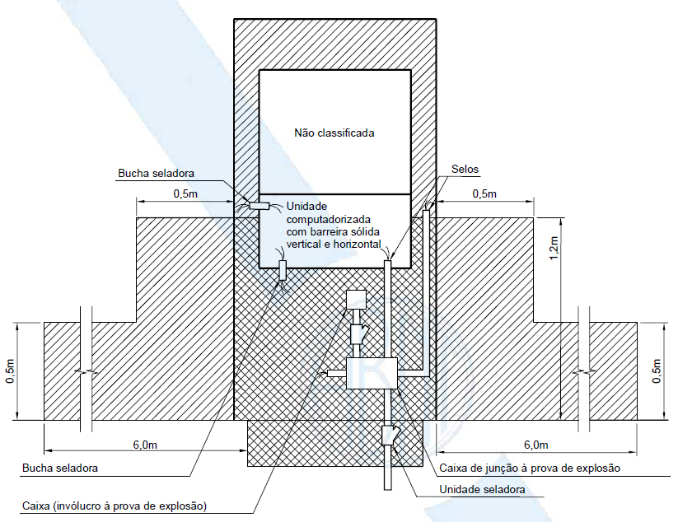
EZID CONFIGURATION
EZID INSTALLATION: NRB 14639:2001
Notes:
Not classified
Computerized unit with solid vertical and horizontal barrier
Sealing bushing
Seals
0.5m
6.0m
Sealing bushing
Box (explosion-proof enclosure)
Explosion-proof junction box
Sealing unit

Slide 99
PHYSICAL CONNECTION OF PUMPS
Cabling
The automation data cable is the AWG by default. For the majority of the cases only two-way data will be used. Only the Schlumberger/Tokheim pumps use three-way cables.
The AWG numbers to be used are:
AWG 18 – The most stable
AWG 20
AWG 22
AWG 24 – The less stable
The greater the AWG number, the thinner the cable, therefore more vulnerable to the adverse conditions of a gas station.
Another rule is never to connect the grounding loop to automation.

Slide 100
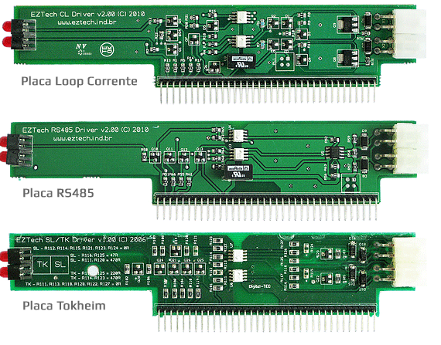
PHYSICAL CONNECTION OF PUMPS
Slots
The connection between the controller and the pumps is done by means of connectors that connect the pumps to the interface boards on the rear part of the controller. Each interface board has 2 connectors, each one with two outlets.
There are four types of interface boards: Current loop, RS485 and/or Schlumberger/Tokheim, COMPAC which fulfill the majority of specifications for the pumps of the national market and require specific connections.
Notes:
Current Loop Board
RS485 Board
Tokheim Board

Slide 101
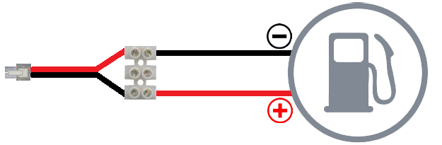
PHYSICAL CONNECTION OF PUMPS
Conventional connection

Slide 102
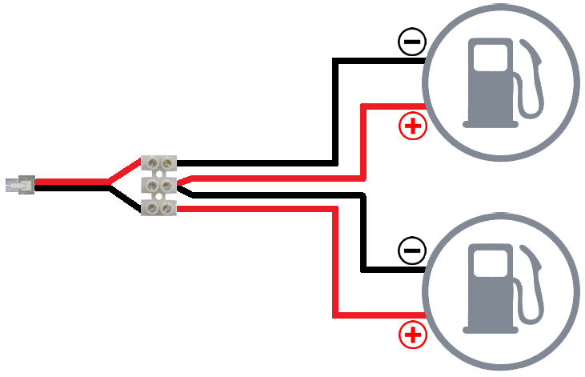
PHYSICAL CONNECTION OF PUMPS
Connection in series (only Loop)

Slide 103
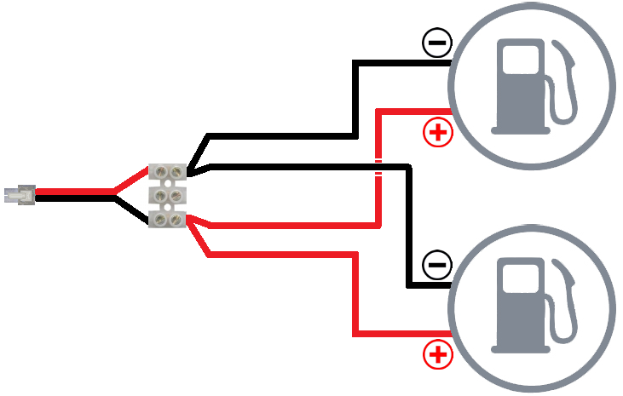
PHYSICAL CONNECTION OF PUMPS
Connection in parallel (only RS485)

Slide 104
PHYSICAL CONNECTION OF PUMPS
Pumps connection table
Manufac- turer | Voltage | Description
All | < 0.2v | The positve and negative wires are shorted, it can be a short on the cable, the slot or the pump’s busbar.
 | > 10v | The loop is not closed. It is probable that the cable is not connected to the pump or ruptured, or the pump busbar is open.
Wayne | > 0.4v and < 1.2v | The positive and negative wires are inverted.
 | > 2.0v and < 4.0v | The connection is correct.
Gilbarco | > 2.3v and < 2.7v | The positive and negative wires are inverted.
 | > 1.5v and < 2.0v | The connection is correct.
Stratema | 3.4v | The connection is correct
 | 2.6v | The positive and negative wires are inverted.
EZID: Automation CL = 2.3V
Pump CL = Same voltage of pumps table above

Slide 105
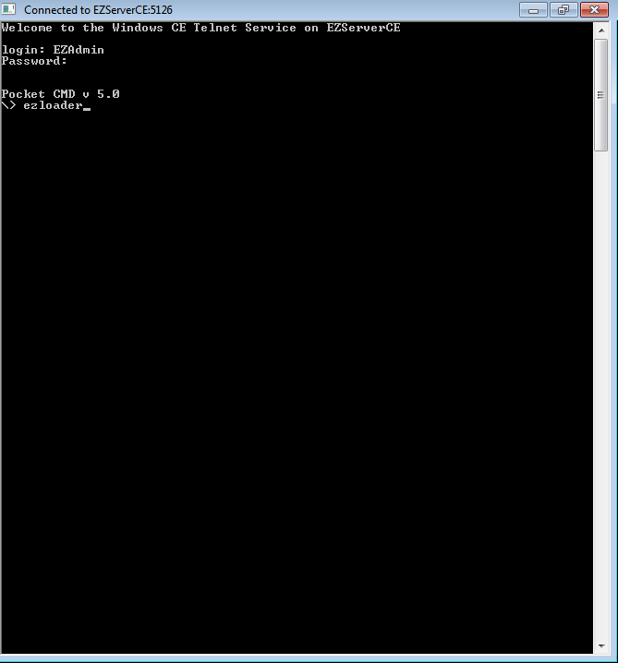
CONFIGURATION
Wireless
CONFIGURATION OF THE CHANNEL AND THE PAN ID
The Channel is the automation frequency and the PAN ID is the address of the Wireless network. The components will communicate only if they are in the same Channel and in the same PAN ID.
It is possible to configure by the EZTelnet using the commands in the EZTelnet.

Slide 106
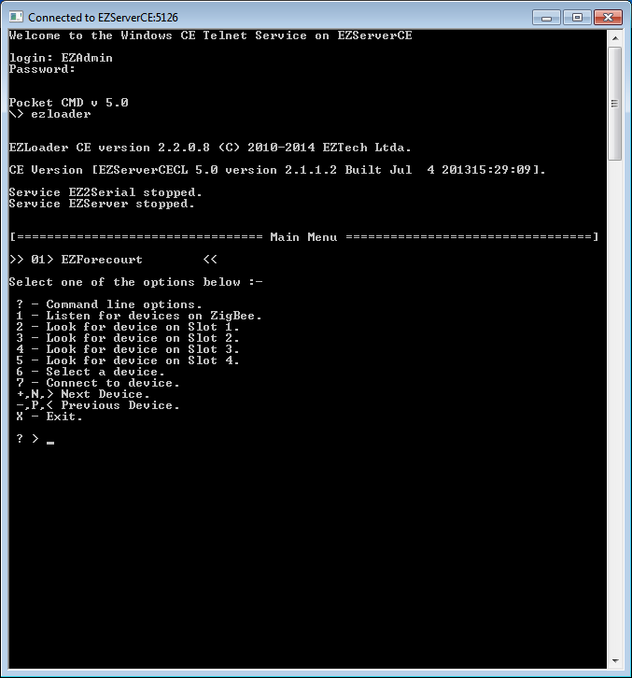
CONFIGURATION
Wireless
CONFIGURATION OF THE CHANNEL AND THE PAN ID
? – Command line options
1 – Look for all the devices on the
ZigBee network (with the same Channel and Pan ID)
2 a 5 – Look for devices on slots 1 to 4
6 – Select a device
7 – Connect to a device
N – Next device
P – Previous device
X – Exit

Slide 107
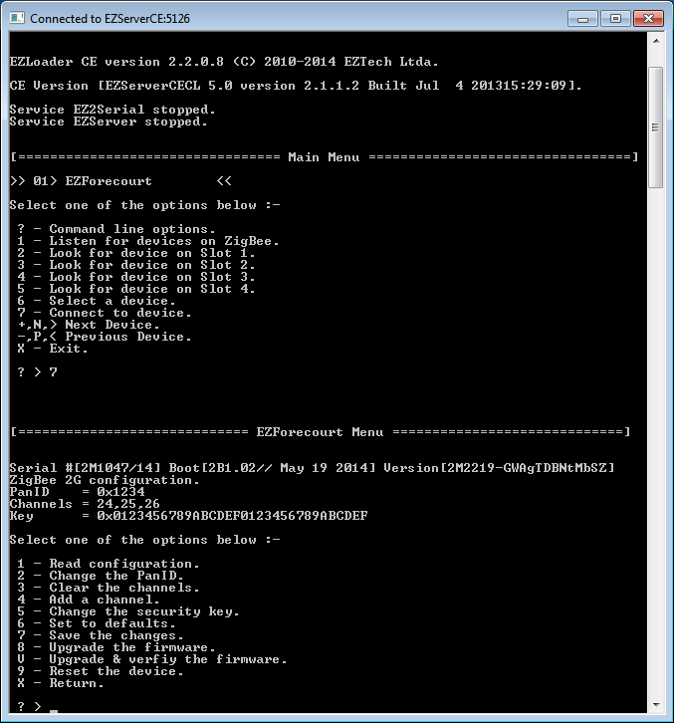
CONFIGURATION
Wireless
CONFIGURATION OF THE CHANNEL AND THE PAN ID
1 – Read the configuration
2 – Change the PanID
3 – Clear the channels
4 – Add a channel
5 – Change the security key
6 – Set to default
7 – Save the changes
8 – Upgrade the firmware
V – Upgrade & verify the firmware
9 – Reset the device
X – Return

Slide 108
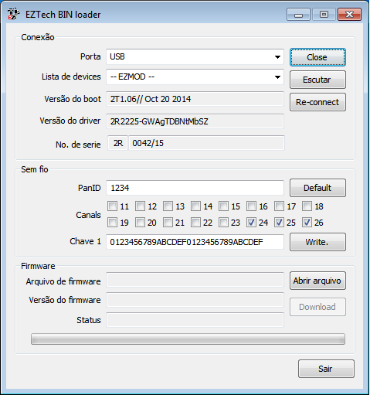
CONFIGURATION
Wireless
The EZLoader application installed in the computer can help to perform the Zigbee network configuration and even to update the firmware only of the EZRemotes

Slide 109
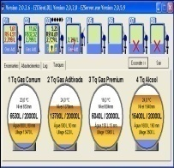
COMMUNICATION
Pump CPU
EZRemote
EZForecourt
Data Cable
Data

Slide 110


COMMUNICATION
Pump CPU
EZRemote
EZForecourt
Data Cable
Data

Slide 111

COMMUNICATION
Pump CPU
EZRemote
EZForecourt
Data Cable

Slide 112

COMMUNICATION
Pump CPU
EZRemote
EZForecourt
Data

Slide 113
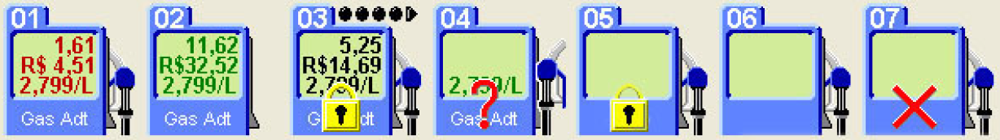
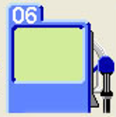
COMMUNICATION
²
²
Fuelling in the memory for more than one minute. Nozzle in the PA.
PA fuelling. Nozzle out of the PA fuelling.
PA with multiple fuelling in the memory. PA locked. Nozzle in the PA.
PA waiting to be activated. Nozzle out for the waiting to be activated.
PA locked. Nozzle in the PA.
PA released. Pump in the PA.
PA does not communicate with the automation.
Abastecimento na memória a mais de um minuto. Nozzle no PA.
PA abastecendo. Nozzle fora do PA abastecendo.
PA com múltiplos abastecimentos na memória. PA trancado. Nozzle no PA.
PA esperando ser ativado. Nozzle fora a pump aguardando ativação.
PA trancado. Nozzle no PA.
Problem with the automation service (switched off or with error).
EZRemote does not communicate with the automation.
²
²

Slide 114
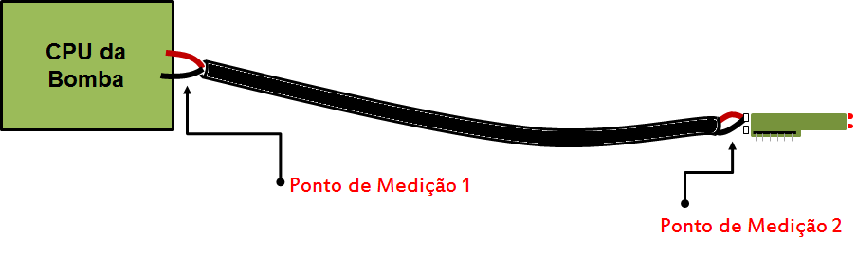
COMMUNICATION
Metering in the 20Vdc scale in the digital multimeter.
The metering that appears in point 1 has to be equal to the metering of point 2 in this scale with all the cables connected.
Approximately 10 Vdc is the voltage only for the slot, a voltage drop occurs when a Loop pump is connected in the automation.
Inverting the ponteirs of multimeter keeps alternating the values between + and -, but the absolute number does not change.
You have different metering by inverting the polarities of the data cable.
Notes:
Pump CPU
Metering Point 1
Metering Point 2

Slide 115
PHYSICAL CONNECTION OF PUMPS
Pumps connection table
Manufac- turer | Voltage | Description
All | < 0.2v | The positve and negative wires are shorted, it can be a short on the cable, the slot or the pump’s busbar.
 | > 10v | The loop is not closed. It is probable that the cable is not connected to the pump or ruptured, or the pump busbar is open.
Wayne | > 0.4v and < 1.2v | The positive and negative wires are inverted.
 | > 2.0v and < 4.0v | The connection is correct.
Gilbarco | > 2.3v and < 2.7v | The positive and negative wires are inverted.
 | > 1.5v and < 2.0v | The connection is correct.
Stratema | 3.4v | The connection is correct
 | 2.6v | The positive and negative wires are inverted.
EZID: Automation CL = 2.3V
Pump CL = Same voltage of pumps table above

Slide 116
ADVANCED
EZFORECOURT PLUS
WINDOWS CE
HARDWARE
COMM. TCP/IP
(CEMod)
EZServer
EZMod and/or
EZRemote
EZDriver
PUMPS
DRIVER
(EZMod)
EZLoader

Slide 117
ADVANCED
Backup
The data base of configurations and fuelling for the two Automations is the EZServer.NV that in the EZForecourt Plus this file stays inside the automation, and in the EZForecourt USB the file stays in the PC.
There is another backup file called EZConfig.ini that is not a data base, carries the configuration information and can be reinserted inside the automation.

Slide 118
ADVANCED
Backup
2 forms of backup:
config.ini file (Plus and USB) not for the service
EZServer.NV file (Plus) and for the service
Various modes:
CONFIG.INI
Prompt do DOS;
Logs;
EZServer.NV
FTP;
EZSetup;
After carrying out an installation always backup the configurations.

Slide 119
ADVANCED
.INI Files
EZServer.ini
Intelligence of automation
EZDriver.ini
Characteristics of pumps
EZClient.ini
Communication ports

Slide 120
ADVANCED
EZServer.L00
Connected to the EZServer
Status of pumps
Status of the EZRemote
Fuelling
Internal logic
Memory
Internal changes
DRV01.L00
Connected to the EZDriver - pumps
Machine language of pumps
Machine language of the EZRemotes
DRV06.L00
Connected to the EZDriver – Tanks
Protocol of the meters
EZClient.L00
Connected to the EZClient
Status de Communication status of client applications
EZMonitor and EZConfig
Management System
Emulation
Logs
To generate the error log:
In the EZForecourt Plus, run the option “Recover Logs” at the EZForecourt Plus folder from the Windows startup menu. This procedure generates a file called “Logs.zip” at the folder C:\EZServerCe\Logs.
In the EZForecourt USB, compact the contents of the folder C:\EZForecourt\Log.

Slide 121
ANALYSIS OF LOGS
Structure
EZSERVER.Lxx
1. FUELLING
2. COMMUNICATION ERRORS
a. COMMUNICATION WITH THE PUMP
b. COMMUNICATION WITH THE EZREMOTE
c. COMMUNICATION WITH THE CLIENT
3. ABNORMAL FUELLING
a. FUELLING GENERATED BY THE DIFFERENCE OF CLOSURE
b. FUELLING GENERATED BY THE DISPLAY
c. DUPLICATED FUELLING
4. INITIALIZATION AND OTHER MESSAGES

Slide 122
ANALYSIS OF LOGS
FUELLING
Is divided into 4 parts in the following order: the pump authorization, the nozzles status, the fuelling conclusion and the pickup by the management at the end.
26/07/2014 18:17:19 ****TIME <EZServer service executable Version(2,2,0,3:A) Built(Jun 29 2014 at 12:23:43)>
307187ms Pump [04] Authorise in CheckForAuth
1ms Pump [04] new state IDLE -> CALLING virtual state AUTHED (DEL_IDLE)
1004ms Pump [04] new state CALLING -> DELIVERY_STARTING virtual state CALLING (DEL_IDLE)
3707ms Pump [04] new state DELIVERY_STARTING -> DELIVERING virtual state DELIVERY_STARTING (DEL_IDLE)
18495ms Pump [04] new state DELIVERING -> IDLE virtual state DELIVERY_STARTING (GET_DELIVERY)
1936ms Pump [04] Delivery logged, hose 2, 2.999$/L, 6.670L, $20.00 Tag FFFFFFFFFFFFFFFF, PriceLevel 1
321ms Pump [04] e-totals, Hose 2 $788850.81 -> $788870.81 = $20.00, 2084956.280L -> 2084962.960L = 6.680L
37ms Pump [04] Delivery 9596 completed, type 1, hose 2, level 1, 2.999$/L, 6.670L, $20.00, tag FFFFFFFFFFFFFFFF, duration 20, Attendant ID -1, Client ID -1
533ms Pump [04] delivery 9596 cleared by 1

Slide 123
ANALYSIS OF LOGS
1. Version date time of the EZForecout:
26/07/2014 18:17:19 ****TIME <EZServer service executable Version(2,2,0,3:A) Built(Jun 29 2014 at 12:23:43)>
2. Pump authorization
Can take place automatically if nothing exists to manage the authorization
307187ms Pump [04] Authorise in CheckForAuth
Or if there is a form of authorization, by EZTech is given in the form of tags (cards)
539328ms Pump [03] tag read C0191CA8 type 6
1276ms Pump [21] tag read 12B49197 type 1
The possible kinds of TAG type are as follows:
ATTENDANT_TAG_TYPE = 1
BLOCKED_ATTENDANT_TAG_TYPE = 2
WRONG_SHIFT_ATTENDANT_TAG_TYPE = 3
CLIENT_TAG_TYPE = 4
BLOCKED_CLIENT_TAG_TYPE = 5
UNKNOWN_TAG_TYPE = 6

Slide 124
ANALYSIS OF LOGS
If the answer for the authorization is negative one of the following messagens will appear:
6ms Pump [03] tag blocked C0EC19A8 means that the card is not from a gas station attendant nor registered client
0ms Pump [03] tag auth blocked not idle means that the pump is not idle or calling so that it can be authorized
Or if the answer is positive we will have the following message:
1276ms Pump [21] tag read 12B49197 type 1 Automation reads the card and identifies its type
9ms Pump [21] Preset loaded 0.000 Check if any preset exists
0ms Pump [21] enabled
20ms Pump [21] AttendantID 13 , CardClientID -1 saved.
9ms Pump [21] Authorise in CheckForAuth Checks the authorization
4ms Pump [21] attendant 13/client -1 authorised, tag 12B49197 Identifies that this form of fuelling is authorized

Slide 125
ANALYSIS OF LOGS
3. Start of fuelling, at this moment we will see the nozzle status:
1ms Pump [04] new state IDLE -> CALLING virtual state AUTHED (DEL_IDLE)
1004ms Pump [04] new state CALLING -> DELIVERY_STARTING virtual state CALLING (DEL_IDLE)
3707ms Pump [04] new state DELIVERY_STARTING -> DELIVERING virtual state DELIVERY_STARTING (DEL_IDLE)
18495ms Pump [04] new state DELIVERING -> IDLE virtual state DELIVERY_STARTING (GET_DELIVERY)
THESE ARE STATUS THAT COME FROM THE PUMP, AND DEPEND ON THEIR PROTOCOL.
IDLE – Idle
CALLING – Nozzle out, waiting to be armed (authorization)
DELIVERY_STARTING – Nozzle out, but still without processing any fuelling
DELIVERING – Nozzle fuelling
DELIVERY_FINISHING – Nozzle after a fuelling, outside the pump
DELIVERY_FINISHING is also a status liable to appear (DEPENDING ON THE PUMP).
The message virtual state is the virtual status in the EZMonitor. Not every pump passes all the messages of what is really happening.

Slide 126
ANALYSIS OF LOGS
4. Conclusion of the fuelling. At this moment it has all the fuelling logic.
1936ms Pump [04] Delivery logged, hose 2, 2.999$/L, 6.670L, $20.00 Tag FFFFFFFFFFFFFFFF, PriceLevel 1
321ms Pump [04] e-totals, Hose 2 $788850.81 -> $788870.81 = $20.00, 2084956.280L -> 2084962.960L = 6.680L
37ms Pump [04] Delivery 9596 completed, type 1, hose 2, level 1, 2.999$/L, 6.670L, $20.00, tag FFFFFFFFFFFFFFFF, duration 20, Attendant ID -1, Client ID -1
Where below we have the message that comes from the pump’s display. Information of PA, nozzle, price per liter (PPL), volume, value, card ID (FFFFFFFFFFFFFFFF means no card), price level:
1936ms Pump [04] Delivery logged, hose 2, 2.999$/L, 6.670L, $20.00 Tag FFFFFFFFFFFFFFFF, PriceLevel 1

Slide 127
ANALYSIS OF LOGS
Where below we have the message of the pump’s closure turn. Information of PA, nozzle, closure of initial value, closure of final value, closure turn of value, closure of initial volume inicial, closure of final volume, closure turn of volume:
321ms Pump [04] e-totals, Hose 2 $788850.81 -> $788870.81 = $20.00, 2084956.280L -> 2084962.960L = 6.680L
Where below we have the fuelling as it was compiled and translated by the automation, recorded in the DB of the EZForecourt or the EZRemote and which will be sent ahead. Information of PA, fuelling ID, nozzle, PPL, volume, value, card, duration in seconds, gas station attendant (when ID-1 means no gas station attendant) and client (when ID-1 means no client):
37ms Pump [04] Delivery 9596 completed, type 1, hose 2, level 1, 2.999$/L, 6.670L, $20.00, tag FFFFFFFFFFFFFFFF, duration 20, Attendant ID -1, Client ID -1

Slide 128
ANALYSIS OF LOGS
5. Fuelling recovered by the Management System or another application
533ms Pump [04] delivery 9596 cleared by 1
At this moment there are three status. locked means that the fuelling was reserved for the specific client. cleared means that the fuelling was picked up and is outside the automation memory. And there is a third one that is Locked and cleared that performs the two steps at the same time, They are three different API’s but the message cleared at the end that carries the greater importance, for it means that the fuelling ws absorbed by the management system.
2ms Pump [05] new state IDLE -> CALLING virtual state CALLING (DEL_IDLE)
1553ms Pump [05] tag read 42CC6748 type 1
6ms Pump [05] Preset loaded 0.000
1ms Pump [05] enabled
37ms Pump [05] AttendantID 4 , CardClientID -1 saved.
8ms Pump [05] Authorise in CheckForAuth
3ms Pump [05] attendant 4/client -1 authorised, tag 42CC6748
272ms Pump [05] hose 1 delivery started 305.
1ms Pump [05] new state CALLING -> DELIVERING virtual state DELIVERY_STARTING (DEL_IDLE)
11/03/2014 22:05:43 ****TIME <EZServer service executable Version(2,1,1,0) Built(Apr 13 2013 at 17:53:00)>

Slide 129
ANALYSIS OF LOGS
143174ms Pump [05] new state DELIVERING -> DELIVERY_FINISHING virtual state DELIVERY_FINISHING (DEL_IDLE)
575ms Pump [05] new state DELIVERY_FINISHING -> DELIVERY_FINISHED virtual state DELIVERY_FINISHED (DEL_IDLE)
167ms Pump [05] Delivery logged, hose 1, 2.594$/L, 75.940L, $196.99 Tag 0000000042CC6748, PriceLevel 1
10ms Pump [05] disabled, LogDelivery.
11ms Pump [05] new state DELIVERY_FINISHED -> IDLE virtual state IDLE (GET_ETOTALS)
1813ms Pump [05] e-totals, Hose 1 $2321036.67 -> $2321233.66 = $196.99, 983554.690L -> 983630.630L = 75.940L
34ms Pump [05] Delivery 405299 completed, type 1, hose 1, level 1, 2.594$/L, 75.940L, $196.99, tag FFFFFFFFFFFFFFFF, duration 145, Attendant ID 4, Client ID -1
24ms Pump [05] AttendantID -1 , CardClientID -1 saved.
1ms pump [05] preset cleared, DeliveryValid
10ms Pump [05] Preset cleared.
8745ms Pump [05] delivery 405299 cleared by 1

Slide 130
EZTECH CALLS
Structure
EZTech Incidents
DAMAGED CONTROLLER (hardware/firmware)
EZREMOTE WITH FAULT (hardware/firmware)
DAMAGED POWER SUPPLY
FUELLING ERROR (Pump > Automation)
Incidents transferred to the Representative/Station
CONFIGURATION OF DIVERGING PUMPS AND NOZZLES
CONFIGURATION OF DIVERGING DE LOCAL NETWORK
OUT OF DATE VERSION
DAMAGED PUMP
APPLICATION OF THE MANAGEMENT SYSTEM
INFRASTRUCTURE (CABLING / ELECTRICAL)
INSTALLATION
OTHERS

Slide 131
EZTECH CALLS
Structure
Support manager: Carlos Eduardo
Site www.eztech.ind.br;
Integration & Support:
Downloads;
Manual;
FAQ;
Skype, nome: eztech.suporte ;
E-mail: suporte@eztech.ind.br;
Telephone: (21) 3285-0110 ext. 1;
Cell Phone TIM: (21) 98150-9438;

Slide 132

COMMERCIAL
Structure
Notes:
NEW COMMERCIAL UNIT IN SÃO PAULO
Offering high performance in all of Brazil for 10 years

Slide 133
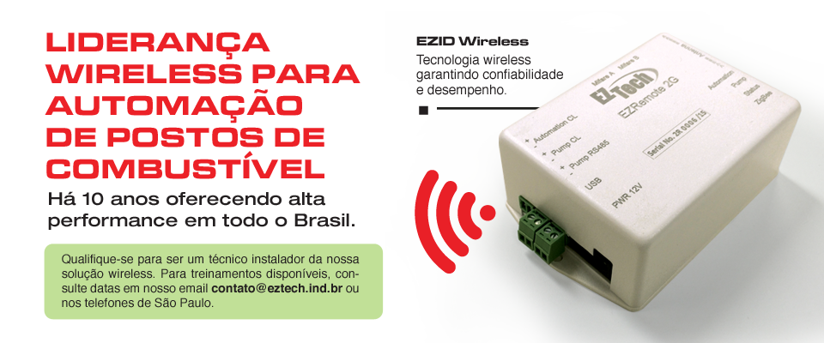
COMMERCIAL
More than 500 stations installed in
less than 6 months!
Notes:
WIRELESS LEADERSHIP FOR AUTOMATION OF GAS STATIONS
Offering high performance in Brazil for 10 years
Qualify yourself to be an installer technician of our wireless solution. For training available, check the dates in our e-mail contato@eztech.ind.br or in the São Paulo telephones.
EZID Wireless
Wireless technology ensuring reliability and performance

Slide 134
CONCLUSION
We are SURE that we will be SUPER partners, and that we will offer jointly an excellent product and service, the fruit of the ties between the partners and EZTech, collecting the fruits through the satisfaction of clients, the financial result obtained from the partners involved and the enrichment of the joint knowledge of all those involved.

Slide 135
TEChNOLOGy and AUTOMAtion
CONCLUSION
Thank you !

